Slide 1
The experiences of Jewish people in early Britain (AD43-1500)
www.ourmigrationstory.org.uk

Slide 2
Jewish people in medieval England
Lesson Objectives
Starter task
To know key dates and events relating to the Jewish community in medieval England
To know where Jewish communities settled in England
To know why Jewish people came to England and describe their relationship with the Crown
To use the poem of Meir ben Elijah to identify aspects of Jewish peoples’ experiences in medieval England
Name 3 groups of immigrants to Britain before 1066.
Extension: For what reasons did these groups come to Britain?
www.ourmigrationstory.org.uk
Notes:
Starter task: this task assumes pupils have covered pre-1066 immigration to Britain, at least in outline.

Slide 3
Timeline of Jewish experiences in medieval England
Medieval England
The Jewish community | 1050 1100 1150 1200 1250 1300
Notes:
Events on the next slide to be placed on the timeline to scale, to give pupils a sense of chronology of events across the period. Can be made quicker by adding some events in each category, or all events in some categories, beforehand.

Slide 4
Key events for the Jewish community in England timeline
England | Jewish community
1066 – The Norman Conquest of England begins | 1070: A group of Jewish merchants are invited to England from Rouen in France by William the Conqueror and settle initially in London
1100 – Henry I is crowned king, succeeding his brother, William Rufus | 1100: The Jewish community is issued a ‘charter of liberties’ by Henry I
1135 – Henry dies without a male heir. For the next 20 years the crown is contested by his nephew, King Stephen, and his daughter, Matilda. This period is known as ‘the Anarchy’ | By 1150: Jewish communities are established across England in towns such as London, Lincoln, Norwich, Oxford, Winchester and York
1154 – Stephen is succeeded by Matilda’s son, Henry II, who carves out the Angevin Empire in France | 1144: The origin of the ‘Blood Libel’, Jewish people are accused of the ritual murder of Christian children
1189 – King Richard, the Lionheart, succeeds Henry II and leads the Third Crusade | 1190: Many Jewish people massacred in York. In Norwich they flee to the city's castle for refuge. Those who stay in their homes are butchered
1199 – King John succeeds Richard and loses most of the English crown’s French possessions, including Normandy, by 1204 | 1230s: Executions in Norwich after an allegation a Christian child was kidnapped by Jewish people
1216 – John is succeeded by his 9 year old son, Henry III, who rules for 56 years | 1270s & 1280s: Edward I enforces extra taxes on the Jewish community. Several are executed for alleged ‘coin clipping’
1272 – Henry is succeeded by his son, Edward I, who reigns until 1307 | 1290: Edward I expels the Jewish community from England
www.ourmigrationstory.org.uk
Notes:
Teachers can add in any further events in the Jewish community column if they wish - events provided as an outline only. The events could be provided on cards to be stuck on to the timeline.

Slide 5
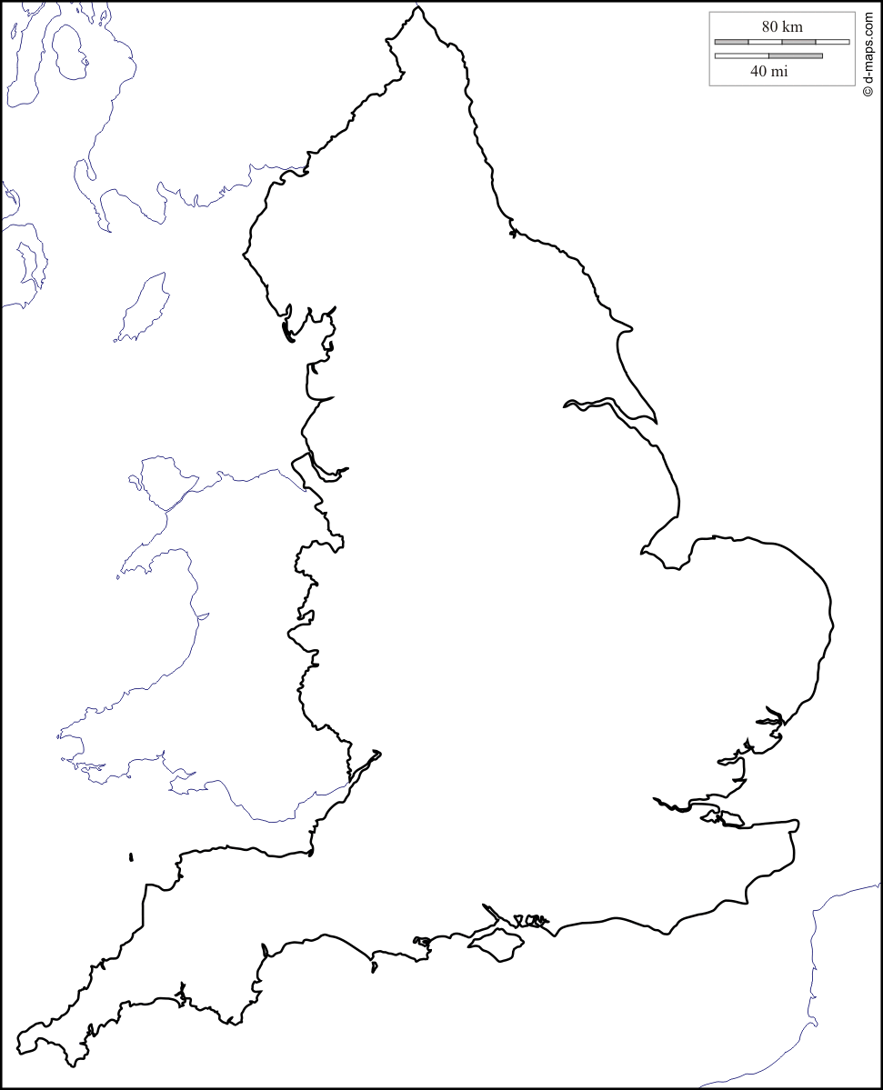
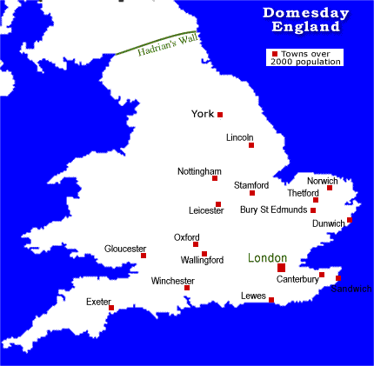
Main Jewish communities in England by 1150
Notes:
Pupils highlight the towns mentioned in the timeline on the map on the left, or use an atlas to find and position the towns on the blank map themselves.

Slide 6
Questions based on Jewish people in early Britain: location, language, culture
Jewish people in medieval England
Why were Jewish people encouraged to migrate to England from Normandy after 1066?
Why couldn’t Christians fill this role?
Where in England had Jewish people settled by the 1200s?
Within each town, where did the Jewish community tend to live and why?
In what way did Jewish people have a different relationship to medieval kings than their Christian subjects?
How did kings benefit from the presence of the Jewish community in England?
In what ways did leaders of the Church seek to change the ways in which Jewish people were treated in England?
How did the reign of Henry III (1216-1272) change the position of the Jewish community in England?
www.ourmigrationstory.org.uk
Notes:
Simple reading and comprehension exercise to identify why Jewish people came to England and characterise the nature of their relationship with the Crown.

Slide 7
What can we learn from this poem about the experiences of Jews in England in the 13th century, and their responses to these experiences?
The land exhausts us by demanding payments, and the people’s disgust is heard 1
While we are silent and wait for the light. 2
You are mighty and full of light, You turn the darkness into light. 3
They make our yoke heavier, they are finishing us off. 4
They continually say of us, let us despoil them until the morning light. 5
You are mighty and full of light, You turn the darkness into light. 6
Extract from Put a Curse on My Enemy, by Meir ben Elijah of Norwich (England, late 13th century)
Notes:
Extract from Meir’s poem, to be analysed – identify what each line is referring to (see Migrant testimonies: Meir's poem, at http://www.ourmigrationstory.org.uk/oms/put-a-curse-on-my-enemies-meir-ben-elijah-and-the-jews-of-early-Norwich for help). Meanings of specific words, like yoke and despoil, may need to be taught explicitly.

Slide 8
Potential exam questions to build towards
Jewish people in medieval England
Give one example of the difficulties faced by Jewish immigrants to Britain in the medieval period. [1 mark] OCR B
Give one reason why Jewish immigrants came to Britain in the medieval period. [1 mark] OCR B
Describe two measures taken by the authorities to control the Jewish community in England between 1100 and 1290. [4 marks] OCR A

